Slide 1
Structuring Your Article

Slide 2





Structure
January 2015
Title
Abstract
Keywords
Introduction
Literature Review
Methods
Results and Discussion
Limitation of the Study
Conclusion
Acknowledgements
References
Supporting materials
Search & find
Tell your story
Provide context
© Reed Elsevier Group PLC
Notes:
Manuscripts contain many sections and each one has a definite purpose.
At the beginning are the Title, Abstract, and Keywords. These all play important roles in allowing the article to be properly indexed and easily found by potential readers through searching. As you probably know from your own experience, these days researchers rarely browse the table of contents of a journal; rather they search for papers based on words and phrases relevant to their current project and interests. These are the advert for your paper, so ensure they are informative, attractive and effective to encourage potential readers to read your full paper.
The main text of the article includes the Introduction, Methods, Results, and Discussion. This is where you must present your work and convey the main messages and findings effectively. Readers’ time is not unlimited so make your article as concise as possible.
The last group of sections bring up the end of the manuscript. The Conclusion, Acknowledgements, References and Supporting Materials.
This should give you a feel for a typical structure but do note that some journals request a different order, for instance that the Discussion section be combined with the Conclusion or Results, while other require different or additional sections, for example some require a R & D section. You should read the guide for authors for the specific criteria of your target journal.

Slide 3
Effective manuscript Titles
Should identify the main issue of the paper
Should be concise
But also accurate, unambiguous, specific, and complete
Should use professional language and avoid rarely-used abbreviations
Will attract readers - short, catchy titles are often better cited
Notes:
Let's look in detail at each section and what it contains, starting with Title.
Effective titles have a number of characteristics. Namely, they:
Should identify the main issue of the paper
Should be concise
But also accurate, unambiguous, specific, and complete because you want the appropriate audience to read your paper; if the title isn’t accurate, the right people may not find or read it and the community would remain unaware of your work, leading to lower citations than the paper deserves.
Should use professional language and avoid rarely-used abbreviations
Will attract readers - short, catchy titles are often better cited
Which means, the best titles contain the fewest possible words that adequately and accurately describe the content of a paper.
Naturally, the title should be discussed and agreed with your co-authors.

Slide 4
Abstract
Keep it as brief as possible
Summarize the problem, methods, results, and conclusions
Make sure it is clearly written and easy to understand
Make sure it is accurate and specific while also being catchy
accurately reflects the content of the paper
Follow the Rule of 10
1-2 sentences: aim
2-3 sentences: materials & methods
2-3 sentences: results
2 sentences: discussion/conclusions
Notes:
If the title catches a reader’s attention, the next thing a potential reader will look at is the Abstract which is always freely available in electronic abstracting and indexing services, such as Web of Science, PubMed, Medline, Embase, and Scopus.
The Abstract should be as brief as possible - a single paragraph is sufficient.
The Abstract should summarize the problem, the methods, the results, and the conclusions.
Consider your writing style - an abstract that is clearly written and easy to understand will strongly encourage the reader to read the rest of your paper.
Think of the abstract as the advertisement for your article since it is freely available via online searching and indexing – make sure it is accurate and specific but also catchy.
Take the time to write the Abstract very carefully. Many authors write the Abstract last so that it accurately reflects the content of the paper.

Slide 5
Keywords
Are the labels of the manuscript
Are used by indexing and abstracting services
Should be specific
Should use only established abbreviations (e.g. DNA)
Article title | Keywords
Enhancing EFL Students’ Autonomous Learning of English Conversation During COVID-19 Via Language-in-talk Log Assignments | Asian EFL Learners, Autonomous Learning, COVID-19, English Language Teaching, Learning Logs, Online Learning
Check the Guide for Authors for any specific guidance on keywords.
Notes:
Next comes the Keywords which are the labels or tags for your manuscript, used by indexing and abstracting services.
The table on this slide contains a good examples of keywords that are associated with an article. As you can see:
First, keywords should be specific enough to give someone a very quick idea about the content of your paper but not so specific that no one would be searching for the word. To help you with this you should search the author keywords of articles relevant to your manuscript and see how many results are returned e.g. “nanomaterials” which returns 33,000 results is too general, while “nanosimluation” which returns only 5 results is too narrow.
Second, you should limit repetition with words already in the title as much as possible.
Third, you should use only abbreviations that are firmly established in the field of study, e.g. DNA.
Some journals have special requirements for keywords, such as providing authors with a list to select from, so check the guide for authors to see if that is the case for your journal of interest.

Slide 6
Introduction
Explain the problem
Describe your approach
Why is it important? What is novel compared to what is already available in the literature?
Mention existing solutions and limitations
.Are there any existing solutions? If so, what is the best solution and what are its limitations?
How does your proposed study aim to progress on this? What makes yours different or better?
Notes:
Moving into the main part of the article, the Introduction, Methods, Results and Discussion.
The Introduction is used to provide a brief context for your manuscript and convince readers why your work advances a field of study.
1. A good introduction should start with the why - explain what the problem is that you are trying to solve to give a clear motivation for the work.
2. You can then move into the how and give a High level description of your approach. Why is it important? Why is it difficult? What is novel compared to what is already available in the literature?
3. Next, identify existing solutions and limitations: Are there any existing solutions? If so, what is the best solution and what are its limitations and how does your proposed study aim to progress on this? What makes yours different or better?
A couple of paragraphs is usually sufficient for a regular article while introductions of letters can be shorter, sometimes only one paragraph. This section shouldn’t be a history lesson, you can’t summarise the whole field, but you should introduce the main scientific publications on which your work is based. Cite a couple of original and important works, including recent review articles, to give the reader a sense of how your work fits into the literature. However, take care to not make citations to irrelevant references, including your own.
Although it can be tempting to re-use introductions from your previous papers on similar studies, every paper should present a new result and the work should be specifically motivated. This requires a unique introduction every time.

Slide 7
Methods
Describe how the problem was studied
Explain the methodology
Identify the instruments/equipment and materials used
Identify participants
Notes:
The Methods section comes next and describes how you studied the problem.
It is important to be detailed, to the extent that a knowledgeable reader would be able to reproduce the experiment. Diagrammatic summaries or embedded video demonstrations may be helpful.
Any previously published procedures should not be re-written in detail but should be mentioned in the methods or described in the Supporting Materials sections, and correctly referenced; modifications should be noted.
The equipment and materials used in experiments should be identified, along with their sources and related product information (company, molec. weight, purity, etc.) if there is the chance for variability of quality of these items.
If the work is computational or theoretical, then the code, computational, or analytical methods should be described.
Write out full chemical/biological compound names (followed by abbr.) then use abbreviations throughout paper and make sure that all symbols are defined.
Present proper control experiments

Slide 8
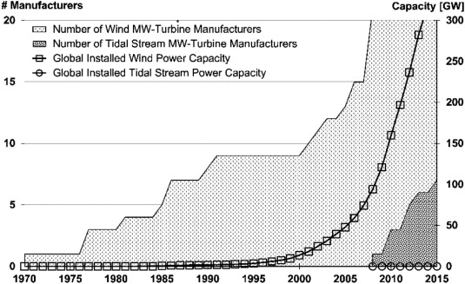
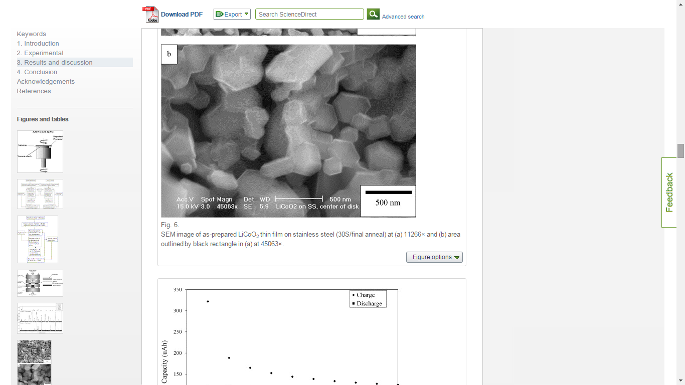
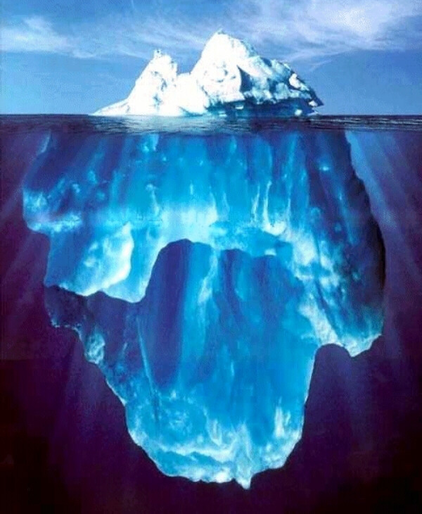
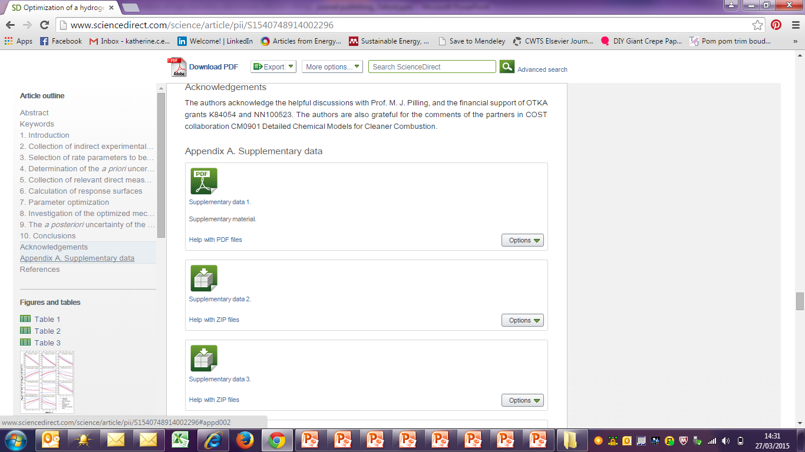
Results
Include only data of primary importance i.e. the main and unexpected findings (use supplementary data for data of secondary importance)
Use sub-headings to keep results of the same type together and avoid redundancy
Use figures and tables for efficiency and clarity
Provide factual analyses
Notes:
The Results section follows, and contains an analytical description of data with minimal interpretation of results and/or comparison with literature.
When writing your results section:
You should include only data of primary importance in the results, and include additional supporting results in the supplementary data section or in a data repository to which you can link from your article. You should be careful not to hold back data in the hopes of publishing it as a separate paper later, as this way you could lose important data that gives additional weight to your main results.
You should consider use sub-headings to keep results of the same type together. These also help with organising your paper as you can then easily refer back to the relevant section when writing your discussion to avoid duplicating text.
Use figures and tables to make the data as clear and easy to understand as possible. In fact, many readers head straight for the figures when they start reading the main part of the paper.
You should provide statistical analyses to show the certainty on your results.
I’ll now give you a few tips for visualisations and tables.

Slide 9
Results - visualisations
The caption and legend should be self-explanatory to enable the figure to stand alone.
Use colour ONLY when necessary
Graphs: un-crowded plots; restrict data sets (symbols to distinguish); well-selected scales; axis labels; label size.
Photos: scale marker; do not manipulate the image to enhance the results.
Notes:
Some general guidance to start:
First, the caption and legend of a figure should be brief and it should contain sufficient explanatory details to explain the figure without the need to refer to the text. Readers often review the figures before they read the entire paper.
Second, it can be tempting to go crazy with colour, but it should be used sparingly and only when absolutely necessary. For instance, if different line styles can clarify the meaning, don’t use colors or other thrilling effects that can distract from the content and may not appear when printed in black and white.
Now some advice on specific types of figures:
Firstly graphs. These are often used to compare experimental results with those of previous works, or with calculated/theoretical values. Graphs should not be crowded with many data sets; try to present at most 3 to 4 data sets per figure. Use well-selected scales with broken axes if needed, label the axes clearly, and use different symbols or line styles so that one can quickly discriminate between the data sets, even in greyscale.
Secondly photographs. These should include a scale marker and the resolution should be clear. You must never manipulate the image to enhance the results – what is portrayed in the paper should remain genuine and authentic.

Slide 10
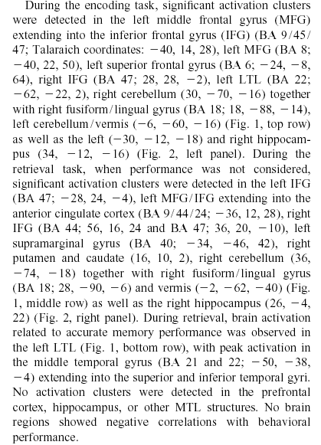
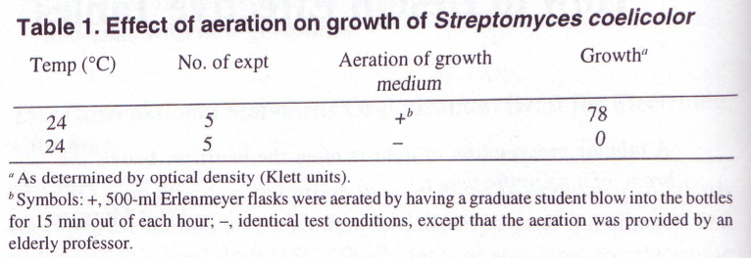
Results - tables
Needs a table
Does not need a table
Growth medium aeration was essential for the growth of S. coelicolor. At room temperature (24°C) in stationary cultures, bacterial growth was not measurable, whereas in aerated cultures, substantial growth was evident (78 Klett units).
Notes:
Now moving onto tables which are used to give actual experimental results. Think carefully about when a table is appropriate and when it isn’t. I have taken a couple of examples from “Writing the biomedical manuscript.” by C. Dant that illustrate this well. Looking to the example on the left where strings of results presented have been presented in a paragraph of text, much better would have been to include a table. Conversely, on the right here you can see a table included that is not necessary – a brief couple of sentences would have been more than sufficient.
Extremely long tables of raw data should not be included in the main article unless absolutely necessary; better would be to include them in the supplementary data section or to post them in a data repository and link to that from the article.

Slide 11
Discussion
Interpretation of results
Most important section
Make the discussion correspond to the results and complement them
Compare published results with your own
Avoid:
Statements that go beyond what the results can support
Non-specific expressions
New terms not already defined or mentioned in your paper
Speculations on possible interpretations that are not rooted in facts
Notes:
The discussion section completes the main part of the paper. The discussion is where you interpret what your results mean and really sell your data. It is arguably the most important section of your paper, and from conversations with our editors we know that a huge number of manuscripts are rejected because the discussion is weak or only includes a mere description of the results.
You should make sure that the discussion corresponds to and complements the results. You should not simply repeat the results here and the sub-sections I mentioned earlier should help to enable this cross referencing and avoid you needing to repeat what you have said before under the results section.
The best discussions go further than the results of the study in question, and compare other previously published results. Critically you should not ignore work in disagreement with yours – confront it and convince the reader why your results are correct or better.
You should be careful:
- To avoid statements that go beyond what your results can support
- To avoid non-specific expressions such as “higher temperature” or “at a lower rate”; use quantitative descriptions instead such as: the temperature increased by x degrees Fahrenheit; following exercise the rate of burn increased to y kcal/min.
- To avoid new terms not already defined or mentioned in your paper
At this stage you may realise that you are not able to support your story because some critical items have not been studied substantially, and if so you will need to perform further experiments.

Slide 12
Conclusion
Explain how your work advances the present state of knowledge
Do not repeat results or the abstract
Discuss uses, extensions, or applications
Suggest future experiments
Notes:
Now to the final sections. In the conclusion you should clearly explain how your work advances the field of study.
You should take care not to simply repeat the experimental results. You should rather indicate uses, extensions, or applications of the work but do not overreach, hence statements such as “this method can potentially be used…” do not belong to the conclusions.
You can suggest future experiments that build on your work and point out any relevant experiments that may already be underway.
The conclusions should also be distinct from the abstract as they serve a different purpose, although some of the same messages may be included.
The conclusion should be clear to help the reviewers and editors judge your work and its impact.

Slide 13
Acknowledgements
Advisors
Financial supporters and funders
Proof readers and typists
Suppliers who may have donated materials
Notes:
The Acknowledgements section is where you can acknowledge the names of the important people or entities who have helped you, but who do not fulfil the criteria for authorship which we will cover later in the ethics section. Examples include: advisors, financial supporters, proof readers and suppliers.

Slide 14
References
Always ensure you have fully absorbed the material you are referencing
Avoid excessive self citations or citations to publications from the same region or institute
Conform to any requirements outlined in the Guide for Authors
Notes:
Finally – references. The reference list is where you cite the main scientific publications your work is based on.
Some tips to help you:
Do not include too many references, especially if they are only tangentially related to your work.
Always ensure that you have fully absorbed and understood the material you are referencing. Do not just rely on reading just the abstract, excerpts, mentions in other papers, or isolated sentences. Know what you’re referencing!
Avoid excessive self-citations of your own work or from a single region or institute to ensure that you are demonstrating your understanding of the full, broad, and international literature, including from research groups with whom you disagree, where applicable.
Check the Guide for Authors to ensure the proper format or requirements in terms of the maximum number of references that may be included.
Consider using a reference manager, such as Mendeley, to build up your reference list simply and with consistent formatting to the journal’s required style, if applicable.

Slide 15

The process of writing – building the article
Title, Abstract, and Keywords
Conclusion
Introduction
Methods
Results
Discussion
Figures/Tables (your data)
Notes:
For most scientific fields, the most efficient way is to regard the manuscript as a wall and build it brick by brick. I would suggest that you follow a different sequence for writing the article than you do for reading it.
Start with producing your tables and figures, with captions/legends since the data is central to the paper.
Then describe the Methods used, the Results found, and the Discussion around these results.
The Conclusion should flow on from this fairly easily.
Then you write the Introduction, explaining where your work fits into the field as a whole.
Finally, you write the Title, Abstract and Keywords so they are fully appropriate to the final content.
This process of building the article is easier, more logical, and more effective that trying to write an article in the sequence it is read.

Slide 16
Publishing Your Article

Slide 17
Are you ready to publish?
Outdated work
Original results or methods
Incorrect conclusions
Significant enhancement of published work
Duplication of published work
Up-to-date review of a subject or field
Not ready Work has no scientific interest
Ready Work advances the field
Notes:
Firstly you need to critically assess if you are really ready to publish.
As a rule of thumb, you SHOULD only consider publishing your research if you have information that advances the understanding in a specific research field. This could take the form of: -Presenting new, original results or methods -Rationalizing, refining, or reinterpreting published results -Reviewing or summarizing a particular subject or field
If these criteria are met, you’ll need a strong manuscript to effectively present your contributions to the scientific community.

Slide 18

What makes a strong manuscript?
A clear, useful and exciting message,
presented and constructed in a logical manner allowing readers to easily grasp the significance.
Editors, reviewers and readers all want to receive well presented manuscripts.
Notes:
So, what makes a strong manuscript? Strong manuscripts have three key characteristics:
First: their scientific message is clear, useful and exciting. Second: their message is presented and constructed in a logical manner. They enable the reader to arrive at the same conclusions as the author, and the format chosen best showcases the material. Third: They enable readers, reviewers and editors to easily grasp the significance of the research. The more effort you put into a manuscript upfront, the more likely it is to be accepted as editors, reviewers and readers all want to receive well presented manuscripts.

Slide 19



What article type should I choose?
Full articles
Substantial, complete and comprehensive pieces of research Is my message sufficient for a full article?
Letters or short communications
Quick and early communications Are my results so thrilling that they should be shown as soon as possible?
Review papers
Summaries of recent developments on a specific top
Often submitted by invitation
Notes:
Your next decision is the appropriate manuscript type. There are various types of manuscripts that suit different purposes:
Full Articles are the most common type of manuscript. These are substantial, complete, and comprehensive pieces of research that are of significance.
Letters or Short Communications are quick and early communications of significant, original advances. These tend to be much more brief than full articles.
Review Papers summarize recent developments on a specific topic, highlighting important points that have been previously reported and introducing no new information. These are often submitted after invitation by an Editor and are generally done only by researchers who are further progressed in their career and established as an authority in the field.
In selecting an article type you need to self-evaluate your work by asking questions such as:
Is my message sufficient for a full article?
Are my results so thrilling that they should be shown as soon as possible in a short communication?
Your supervisor or colleagues are also good sources for advice on manuscript type - sometimes outsiders can see the situation more clearly than you. And of course you must reach a consensus decision with your co-authors.
It’s worth noting there are also new concept or micro articles popping up, such as software articles, methods articles, data articles, which may be useful for presenting aspects of your work that may not be published in detail in traditional articles.

Slide 20
How do I choose the right journal?
Aim to reach the intended audience for your work
Choose only one journal, as simultaneous submissions are prohibited
Supervisor and colleagues can provide good suggestions
Investigate your journal shortlist:
Aims & Scope
Types of articles considered
Readership e.g. academic versus practice
Subscription versus Open Access
Speed of publication
Peer review process (single blind, double blind, open)
Content innovation
Notes:
It is critically important to select the right journal for two main reasons:
If your research is not published in an appropriate journal, it will not reach the intended audience, nor receive the downloads or citations it would had it appeared in a better matching journal.
If your paper is outside the scope of a journal, it will likely be rejected immediately by the editors, not even because of the quality of the work, but because the topic doesn’t fit with the journal, and you’ll have to go back to the drawing board and submit over.
Furthermore, you must not hedge your bets by submitting your manuscript to more than one journal at a time. International ethics standards prohibit multiple or simultaneous submissions, and the editors do find out! If you are concerned about the speed of progress with the journal you submitted to, you must withdraw the manuscript from that journal before submitting elsewhere.
One tip I would share is to consult the articles in your reference list and check which journals they were published in – this will usually lead you directly to the right journals. Also, ask your supervisor and colleagues when you’re deciding where to submit - they may be more familiar with the different journals that are relevant to your field. Remember, you must agree on where to submit with any other authors.
Once you have your shortlist, investigate all candidate journals to find out more about them.

Slide 21
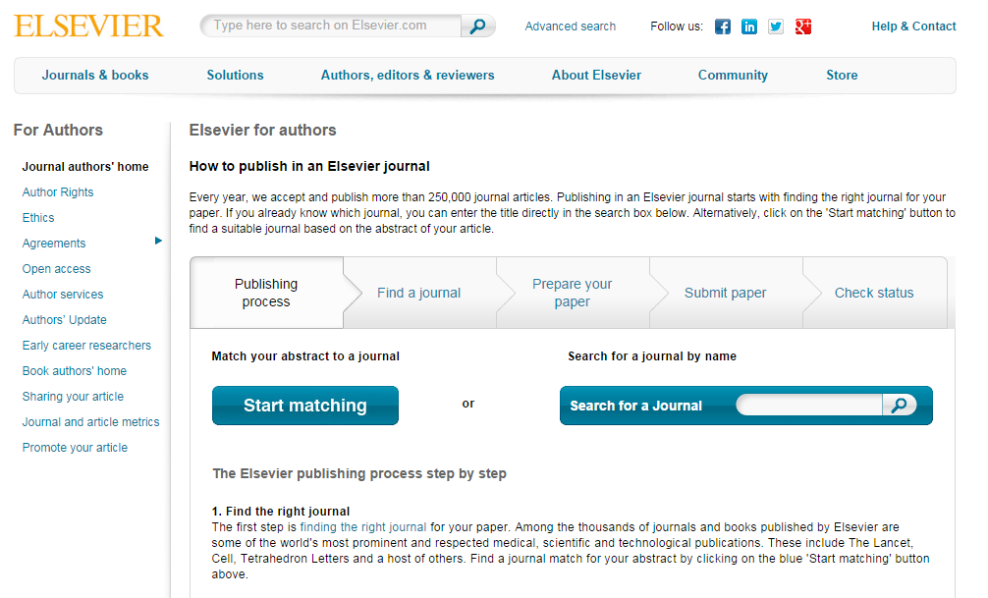
Tools to help you choose the right journal
Notes:
Where can you find all this information. Of course, you can investigate journals by visiting their homepage on the publisher’s website, such as Elsevier.com, but in addition many publishers now have tools to help authors with finding all this information, such as Elsevier’s Journal Finder Tool where you can upload the title and abstract of your article and allow the tool to generate suggested journals by subject using the tool’s powerful matching algorithm. You can then interrogate the results and compare impact factor, editorial speed, open access options, and so on.

Slide 22
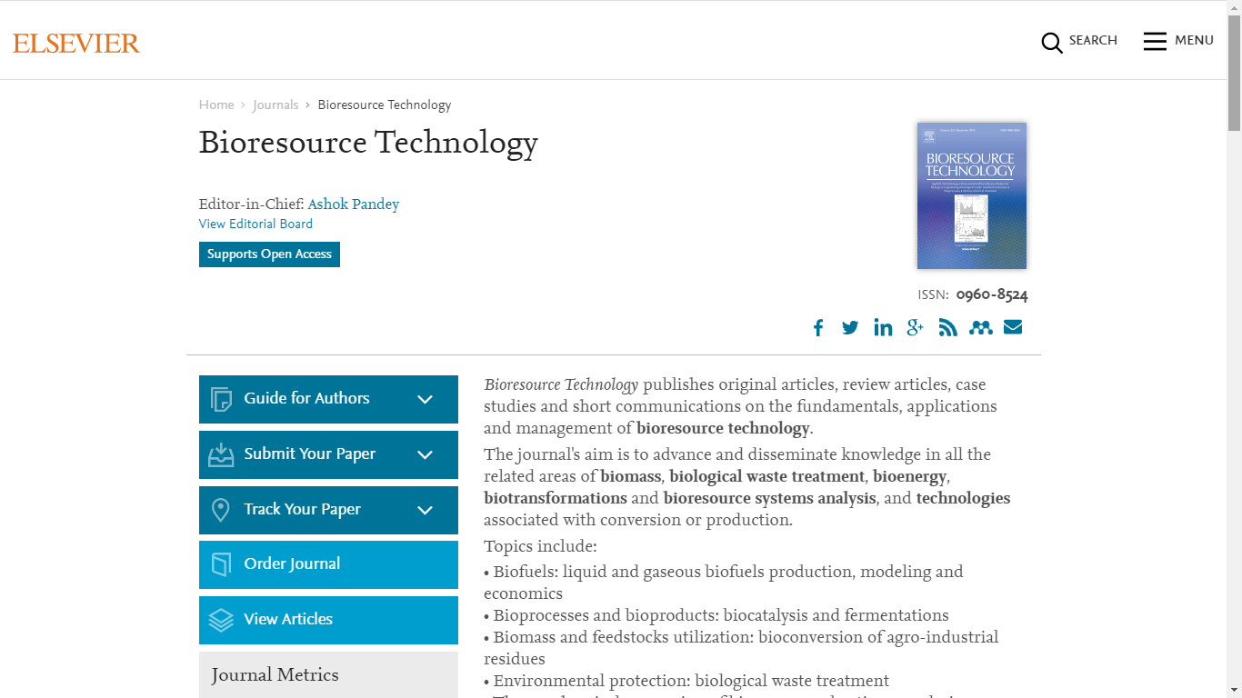
The Guide for Authors
Find it on the journal homepage of the publisher, e.g. Elsevier.com
Keep to the Guide for Authors in your manuscript
It will save your time
Your Paper, Your Way
Reference Simplification
Notes:
Even if you do not use the “Guide for Authors” to research the journal, you will need to consult with the Guide before you begin preparing your manuscript.
I would advise that you apply the guide for authors to your manuscript, even to the first draft. It can help you with the text layout, reference style, nomenclature, figures and tables, and other important items. This will save your time, along with the editor’s and reviewer’s and will give a great first impression to the editor. The two caveats are where journals offer Your Paper, Your Way or Reference Simplification where the paper formatting or reference formatting requirements are relaxed for the original submission.

Slide 23
Submitting Your Paper

Slide 24
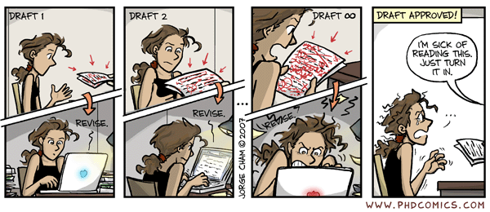
Revise before submission
Notes:
The best advise I can give it to check your paper over and over again to ensure it is vetted as thoroughly as possible before submission. Of course all authors should check and approve the manuscript but you might also ask colleagues and supervisors to review your manuscript for you. If you don’t do this before submission you’ll have to do it during revision, so it’s better to do it upfront and send the editor and reviewers the best possible first impression.

Slide 25
Covering letter
March 2015
Your chance to speak directly to the editors
Explain the main findings and motivation
Highlight novelty and significance of results
State final approval of all co-authors
State prior reviews, revisions, etc.
State any conflicts of interest
Notes:
The final step before submission is to prepare your covering letter which should be submitted along with your manuscript. This is your chance to speak to the editor directly, to mention what makes your manuscript suitable for the journal and important for the field, to confirm that all authors have approved the paper as it is submitted, to mention any special requirements such as reviewer suggestions, and to disclose any conflicts of interest.

Slide 26
Peer-review & responding to reviewers

Slide 27
January 2015
Peer review
Helps to determine the quality, validity, significance, and originality of research
Helps to improve the quality of papers
Publishers are outside the academic process and are not prone to prejudice or favour
© Reed Elsevier Group PLC
Notes:
Peer review has become the filter that is used to evaluate the quality, comment on validity, judge the significance and determine originality of research.
The process also helps to improve the quality of the paper. In a recent study by the publishing research consortium, over 90% of authors agreed that peer review improved the quality of their paper.

Slide 28
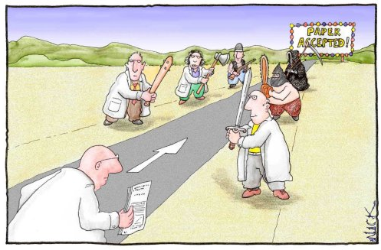
Notes:
This is not how it works…
Source: Nearing-Zero by Nick D. Kim

Slide 29
What actually happens
Notes:
It actually works like this:
First the editor or editorial office check that your paper meets the fundamental requirements for the journal which may include considerations such as the scope, novelty, ethics, English language quality and so on. If your paper does not meet these requirements then your paper will be desk rejected.
If your paper does meet these requirements, your paper will be sent for review. The reviewers are selected by the editor as experts in the topic(s) covered by the paper, and usually editors seek 2 reviews for each manuscript.
Reviewers give recommendations but the decision is ultimately the editor’s. The editor may decide that your paper should be accepted without revision, although this is very rare, rejected, or revised.
If your paper is to be revised, when the revision is resubmitted the paper may or may not undergo further rounds of review.
The length of time this process takes depends on the field and the journal. Editors and journal managers try to accelerate this process as much as possible, by uninviting reviewers that don’t agree to review within a short window of 10-14 days, by setting ambitious deadlines for reviewers to submit their reports (28 days is common) and by reminding reviewers, both as they approach the deadline to submit their report and when they are late.
Source: Michael Derntl. Basics of Research Paper Writing and Publishing. http://www.pri.univie.ac.at/~derntl/papers/meth-se.pdf

Slide 30



What are reviewers looking for?
Importance of the hypothesis
Originality
Clear progression through the paper
Well presented
“ Novelty”
“ Technical” Quality
Notes:
So what are reviewers looking for? Well, essentially the same as the editors:
That the hypothesis posed is important to the field.
That the research is novel and original and will contribute to the development of the field.
Clear progression through the paper delineating the strengths and weaknesses of the methodology, the experimental and statistical approach, and the interpretation of results in a way that is clear and easy to follow. The reviewer should arrive at the same conclusions as you through
That the paper is technically good with a clear and accurate writing style and well presented figures and tables, following the principles described earlier.

Slide 31
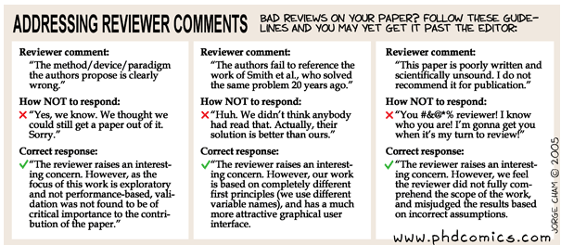
Responding to reviewer comments
Notes:
When a reviewer is not altogether positive and provides constructive criticism it can be easy to be disheartened and become defensive. But it is important to view the review process as constructive and valuable – you have been given insights from your peers at the top of their field and an opportunity to work your paper into the best it can possibly be before it is revealed to the world – make the most of their feedback. This cartoon is of course a little tongue in cheek, but there are still some useful snippets of advice:
Firstly, respond politely, professionally and unemotionally.
Secondly, you don’t have to agree with the reviewer but where you disagree with the reviewers comments you should explain why, backing up your review with further explanation of your work, evidence from the literature or other scientific argument.

Slide 32
Ethical publishing

Slide 33

Authorship definitions
General principles for who is listed first:
First Author:
Conducts and/or supervises the data analysis and the proper presentation and interpretation of the results
Co-Author(s):
Makes intellectual contributions to the data analysis and contributes to data interpretation
Reviews each paper draft
Must be able to present the results, defend the implications and discuss study limitations
Corresponding author (denoted with *):
Puts paper together and submits the paper to journal
Abuses to be avoided:
Ghost Authors:
Leaving out authors who should be included
Gift Authors:
Including authors when they did not contribute significantly
Notes:
The listing of authors can be an unexpectedly tricky situation. Here are some general principles that can be considered to determine first authors and co-authors.
First authors are the ones who conduct or supervise the data analysis as well as the interpretation and presentation of the results.
Corresponding authors put the paper together and submit it to the journal. The corresponding author may be the first author but this is not obligatory.
Co-Authors make intellectual contributions to data analysis and interpretation. Anyone listed as an author should have reviewed drafts of the paper, and they must be able to present, defend, and discuss their study and the results.
Abuses of authorship include:
Ghost authors: leaving out those who should be included
Gift authors: including those who should not be included.

Slide 34

Plagiarism
“Plagiarism is the appropriation of
another person’s ideas, processes,
results, or words without giving appropriate credit, including those obtained through confidential review of others’ research proposals and manuscripts.”
Notes:
Now moving onto the rather meatier issue of plagiarism.
Firstly, what is plagiarism: According to the Federal Office of Science and Technology Policy “Plagiarism is the appropriation of another person’s ideas, processes, results, or words without giving appropriate credit, including those obtained through confidential review of others’ research proposals and manuscripts.”
Why is crediting the work of others (including your advisor’s or your own previous work) by citation important?
To place your own work in context,
To acknowledge the findings of others on which you have built your research, and
To maintain the credibility and accuracy of the scientific literature.

Slide 35
Plagiarism in practice
Any of the following can be plagiarised
Words
Ideas
Diagrams
Figures & tables
Computer programs
Findings
Writings
Information
Lectures
Presentations
Printed material
Electronic material
Copying word for word
Paraphrasing
Text-recycling / self-plagiarism
Notes:
What does this mean in practice? If you copy any part of original work, in any medium without attribution, then you are plagiarising, which includes any of the elements listed on this slide and more.
Did you know that as well as word for word copying *** , plagiarism also applies to paraphrasing *** – restating someone else’s ideas without copying their actual words verbatim?
This means that it would be unacceptable to:
Use exact phrases from the original source without enclosing them in quotation marks
Emulate sentence structure even using different words
Emulate paragraph organization even using different wording or sentence structure
Text recycling*** , also called self-plagiarism, is another grey area. If you publish a paper and in a later paper, copy your Introduction word-for word and perhaps a figure or two without citing the first paper, the Editors may conclude that you intentionally exaggerated your output and reject your paper. It is best to err on the side of caution as far as this is concerned, so always cite/quote even your own previous work.

Slide 36



Plagiarism is easily detected but also easily avoided…
You can use ideas, phrases and arguments from sources already published, just acknowledge the source and the original author, and include any directly copied text within quotation marks.
Notes:
Both plagiarism and duplicate publication are easily detected through iThenticate CrossCheck plagiarism screening software, a huge database of 30+ million articles, from 50,000+ journals, from 400+ publishers. CrossCheck alerts Editors to any textual similarities between the article and this huge database of published articles, and most Elsevier journals now check every submitted article using CrossCheck.
The good news is that although plagiarism is serious it is also easily avoidable. You can use ideas, phrases and arguments from sources already published, just acknowledge the source and the original author and include any directly copied text within quotation marks.

Slide 37
Promoting your research for maximum impact

Slide 38

Preparing your article
Spend time on making sure your paper is clear and concise.
Sharing research data.
Use easy to understand charts and professional illustrations.
Use clear and correct manuscript language.
Notes:
Promoting your research does not begin AFTER your manuscript is finished and has been published online. Promoting your research should be on your mind even whilst you are DOING it and writing up your paper. So, let’s start with some simple but effective tips and tricks for preparing and writing your article:
A good abstract is instrumental. Make sure that your abstract clearly and concisely explains what is new in your paper and why that is important. Be very explicit and don’t assume others will just understand from the context why your findings are interesting. You need to tell them! Consider a sentence that starts with “The reason these findings are important is…” and think about what you would write down there.
After the abstract, most readers will focus on the introduction and conclusion, so spend some quality time on those too. Ask your colleagues to proof-read, and remember that often people working on slightly different topics have the best feedback because they bring a fresh perspective.
Sharing research data is good scientific practice and is key to making your findings reproducible and helping others to build upon these. Elsevier is supporting researchers to store, share, discover and use data - for example by creating bidirectional links between articles and data, and launching data journals.
Charts and illustrations are often used by people to quickly understand what a paper is about – so make sure that your figures are clear and convey your point effectively.
Make sure that your paper is written in good English. If you’re not a native speaker, ask a colleague to proofread or you can make use of professional language editing services.
Finally, Search Engine Optimization, or SEO, will help your article appear higher in the results returned by search engines like Google. SEO your article by using strong keywords in your titles, headings and captions, by linking your paper with other content on the web such as other papers via full citations and with any relevant external data repositories; and by including all details for you and your co-authors that members of your community might look up to find you and your work.

Slide 39


Promoting your article
Platforms
Notes:
Promoting your research also continues some time after it has been published.
On the production and indexing side:
After acceptance, Elsevier will publish your article on ScienceDirect, where 15 million researchers around the globe can access your content. By optimizing this platform and indexing all content, Elsevier works to ensure that your article is more visible and can be found more easily by search engines, library discovery services, A&I databases, and other innovative search and discovery tools. Your article will be accessible immediately after acceptance, and have a unique DOI (Digital Object Identifier), that will always link to the latest available version of your article.
Your article will also be included in Scopus, which is the world’s largest abstract and citation database of peer-reviewed literature and features tools to track, analyze and visualize scholarly research. Its vast database contains abstracts and references from more than 21,000 titles, obtained from over 5,000 publishers worldwide.
In terms of facilitating recognition of your paper in the media:
Elsevier sends our press releases through our media relations team, highlights articles through our social media channels via marketing and creates themed collections on specific scientific topics at the subject level, arranged via publishers or editors.
Elsevier will send you a ‘share link’: a personal, customized short link that you will receive after final publication of your article. It provides 50 days free access to your newly-published article on ScienceDirect to anyone clicking on the link. We encourage you to share this link on social media or on your institutional webpage. The more links there are to your article from a range of relevant websites, such as your university website, the more readers you’ll attract and the higher it will appear on search engine results.

Slide 40
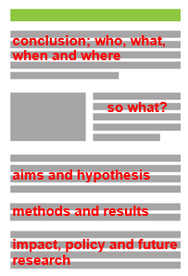
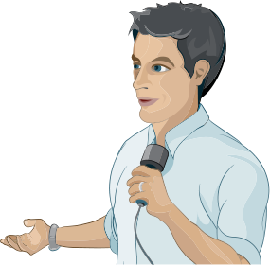




Promoting your article – what you can do
Conferences: network, connect online, online poster
Prepare a lay summary
Use your institution’s communication’s channels
Prepare an audio slide presentation
Keep your profiles up to date with your latest publications
Make full use of social media
Notes:
There are also a wealth of things you can do yourself.
First of all, conferences are a great opportunity for networking and collaboration. It’s always important to:
1. Prepare your conference networking: look at the program to see who will attend and whom you’d like to meet and contact them in advance. Send them links of your published research that relate to the discussions you hope to have with them.
2. Make sure you connect with other delegates on Facebook, LinkedIn, or Mendeley. You can direct them to your website, blog or published research. At the conference itself, be prepared with business cards that include important links to where you showcase your research.
3. If you create a poster for a conference, perhaps accompanied by flyers, you can also post them on your website. And don’t forget that researchers can find it through the Poster in my Pocket app from Elsevier.
There are several other ways, in addition to conferences, to promote your work:
If you would like journalists, media outlets and the public to pick up on your published paper, it can help to have a lay summary which is a short summary of around 5 paragraphs that explains the significance of your research and its key outcomes. It should be in the active voice so as to engage the reader, and in plain English to make it accessible to a wide and non-scientific audience. This statement can be used as a basis for press releases, sharing on social media or other channels available to the public.
These days most institutions have their own press office and PR/media staff. Get in touch with them at an early stage to see what they can do to help you promote your published paper.
Consider preparing an audioslide presentation, a short, webcast-style presentation, in which you present your research in your own words. The presentation appears alongside your article once it is published on Elsevier’s ScienceDirect platform, plus they are free to access and easy to share, independently from the article, with colleagues, (influential) bloggers and on social media including YouTube.
Ensure your publication is listed in your CV, Mendeley and Linked in, and connected to your SCOPUS and ORCID author profiles (and not someone else's!). Also link to your final published article from your personal page at your institute.
Make full use of social media, including LinkedIn, used professionally by around 65 percent of researchers; Twitter, used by one third of all scholars; Facebook, which although popular for personal connections can also be leveraged for professional purposes; and Mendeley which is not just a reference manager but also a Scholarly collaboration network.

Slide 41
Thank You!!!

